Slide 1
Non-Scaling Linear FFAG’s for eRHIC
D. Trbojevic
FFAG workshop 2013 at TRIUMF, Vancouver
September 21, 2013

Slide 2
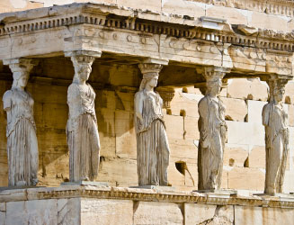
The Pillars of the eRHIC Physics program
spin Physics
Hadronisation
Electro Weak
physics of
strong color
fields
3D Imaging
Wide physics program with high requirements on detector and machine performance

Slide 3
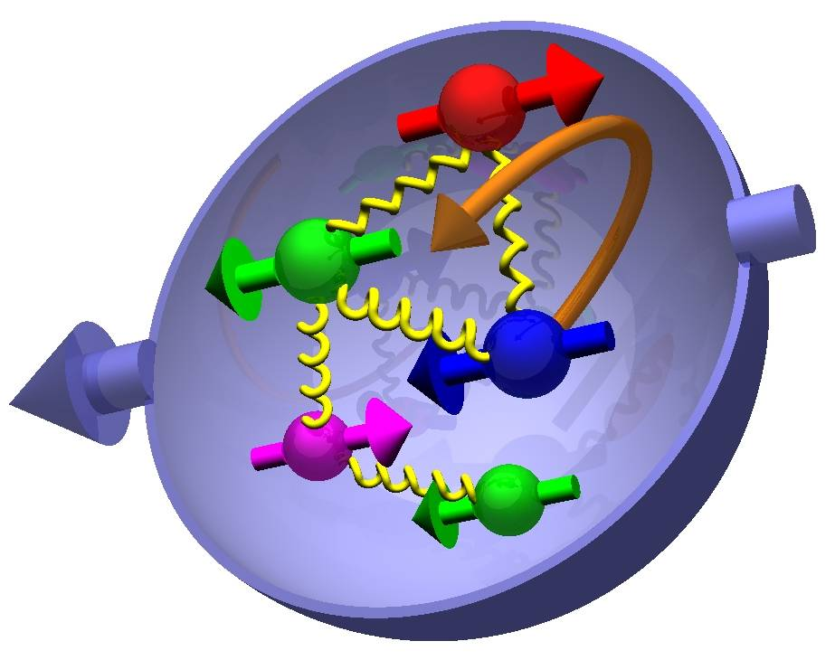
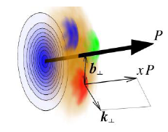

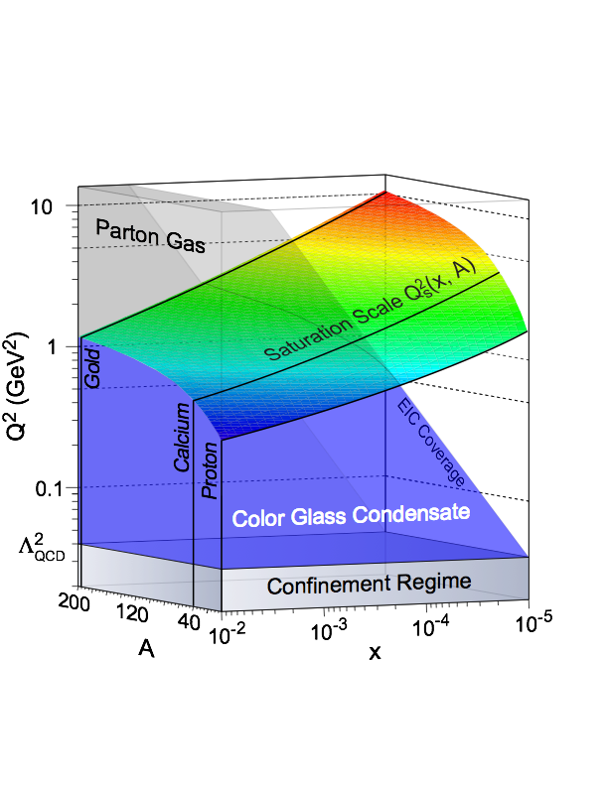
Most Compelling Physics Questions
spin physics
imaging
what is the polarization of gluons at
small x where they are most abundant
what is the spatial distribution of
quarks and gluons in nucleons/nuclei
what is the flavor decomposition of
the polarized sea depending on x
understand deep aspects of gauge
theories revealed by k_{T} dep. distr’n
determine quark and gluon contributions
to the proton spin at last
possible window to
orbital angular momentum
physics of strong color fields
quantitatively probe the universality of
strong color fields in AA, pA, and eA
understand in detail the transition to the non-linear
regime of strong gluon fields and the physics of saturation
how do hard probes in eA interact with the medium

Slide 4

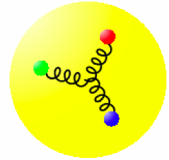
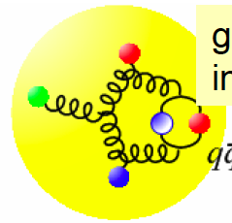
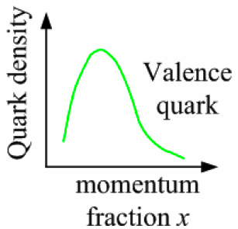
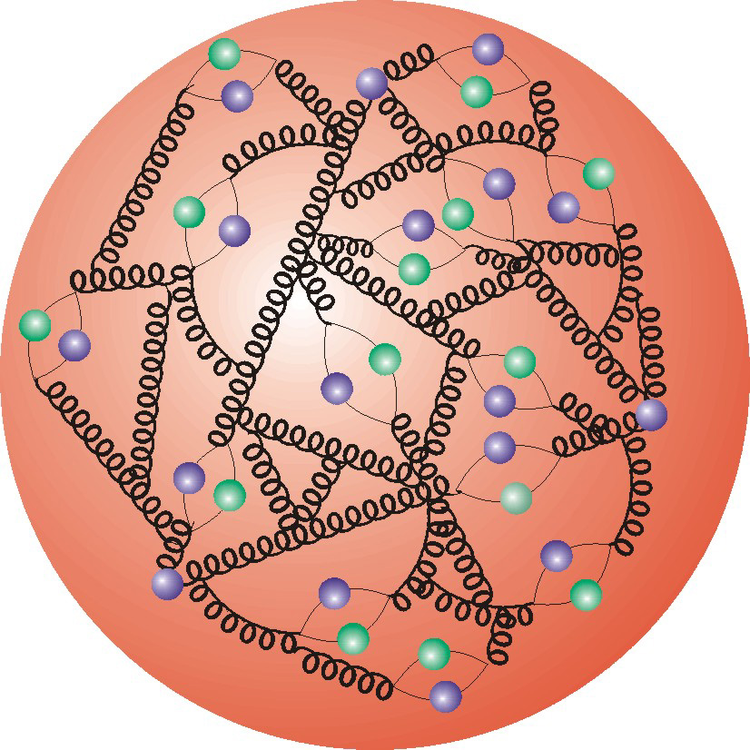
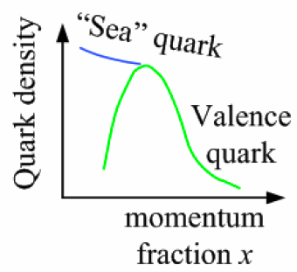
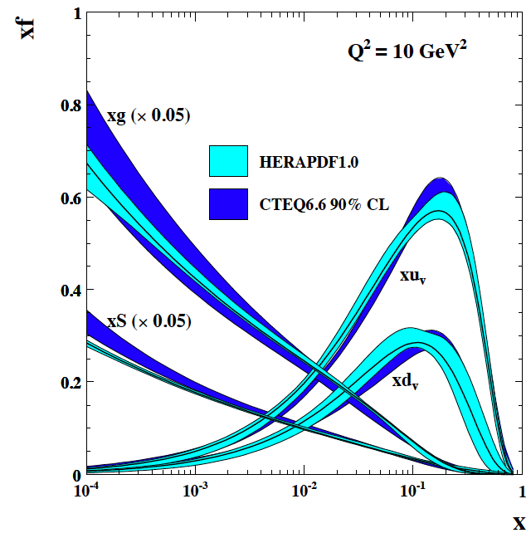
The Probe: Deep Inelastic Scattering
Kinematics:
Measure of resolution power
Measure of inelasticity
Measure of momentum fraction of struck quark
Gluon splits
into quarks
Quark splits
into gluon
splits
into quarks …
10⁻¹⁶m
10⁻¹⁹m
higher √s
increases resolution

Slide 5
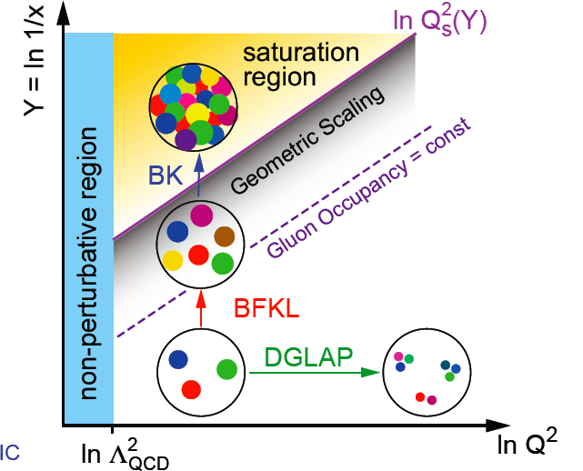
How many gluons have space in A proton?
current theory (DGLAP) has a
built in energy catastrophe
→ G rapid raise violates unitary bound
small x / higher energy
x = P_{parton}/P_{nucleon}
BK/JIMWLK non-linear evolution includes
recombination effects → saturation
  Dynamically generated scale
  Saturation Scale: Q²_{s}(x)
    Increases with energy or decreasing x
  Scale with Q²/Q²_{s}(x) instead of x and Q²
Terra Incognita
Bremsstrahlung
~ α_{s}ln(1/x)
Recombination
~ α_{s}ρ
Saturation must set in at
low x → high occupancy
space becomes crowded gluons start to overlap
→ recombination
α_{s}~1 α_{s} << 1

Slide 6
Layout of the eRHIC inside the RHIC tunnel
2.8-10.0 GeV
Passes through
the #1 FFAG
0.1 GeV
#1 2.8 GeV
#2- 3.7 GeV
#3 4.6 GeV
#4 5.5 GeV
#5 6.4 GeV
#6 7.3 GeV
#7 8.2 GeV
#8 9.1 GeV
#8 10.0 GeV
Linac 0.9 GeV
Coherent Electron
cooling
NS-FFAG 1.0-1.9

Slide 7
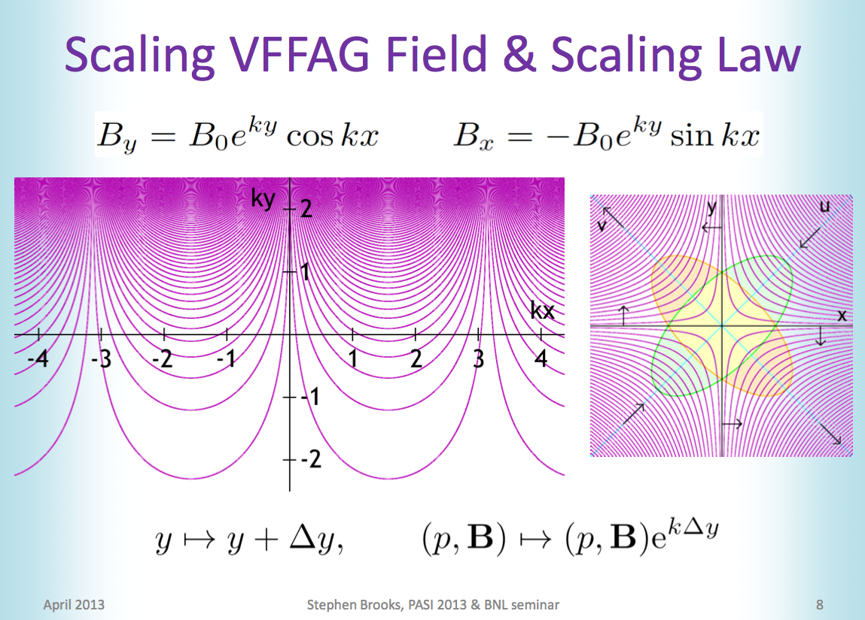
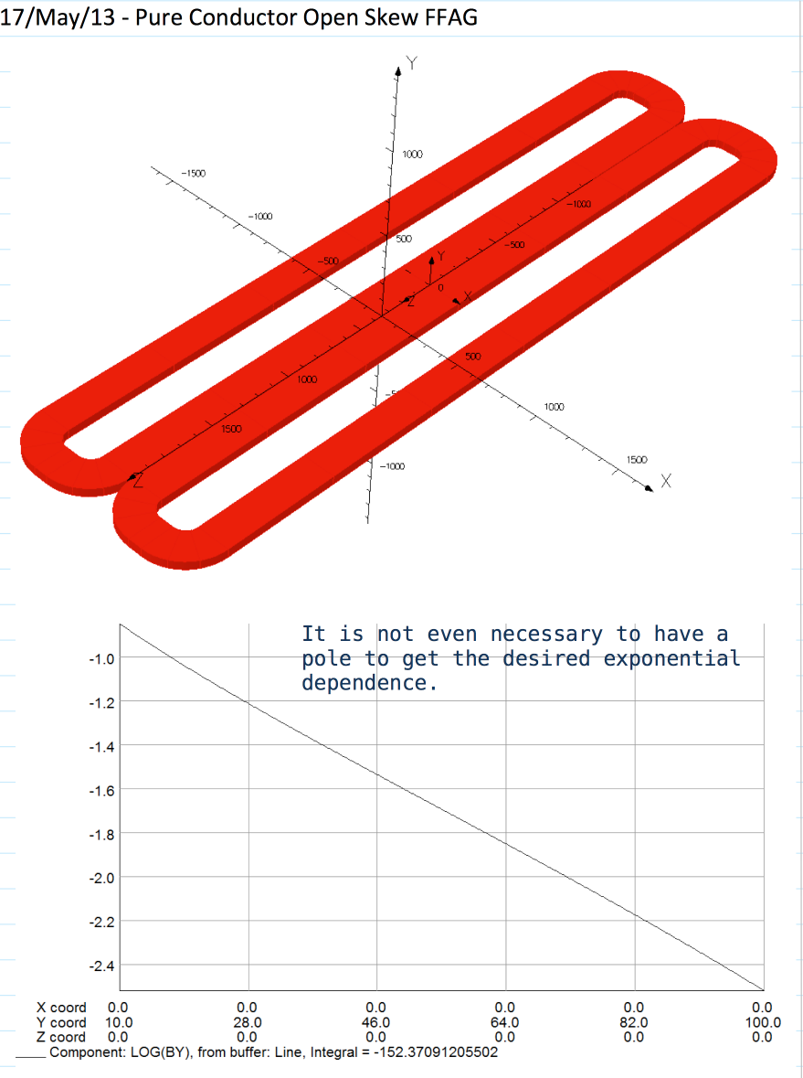
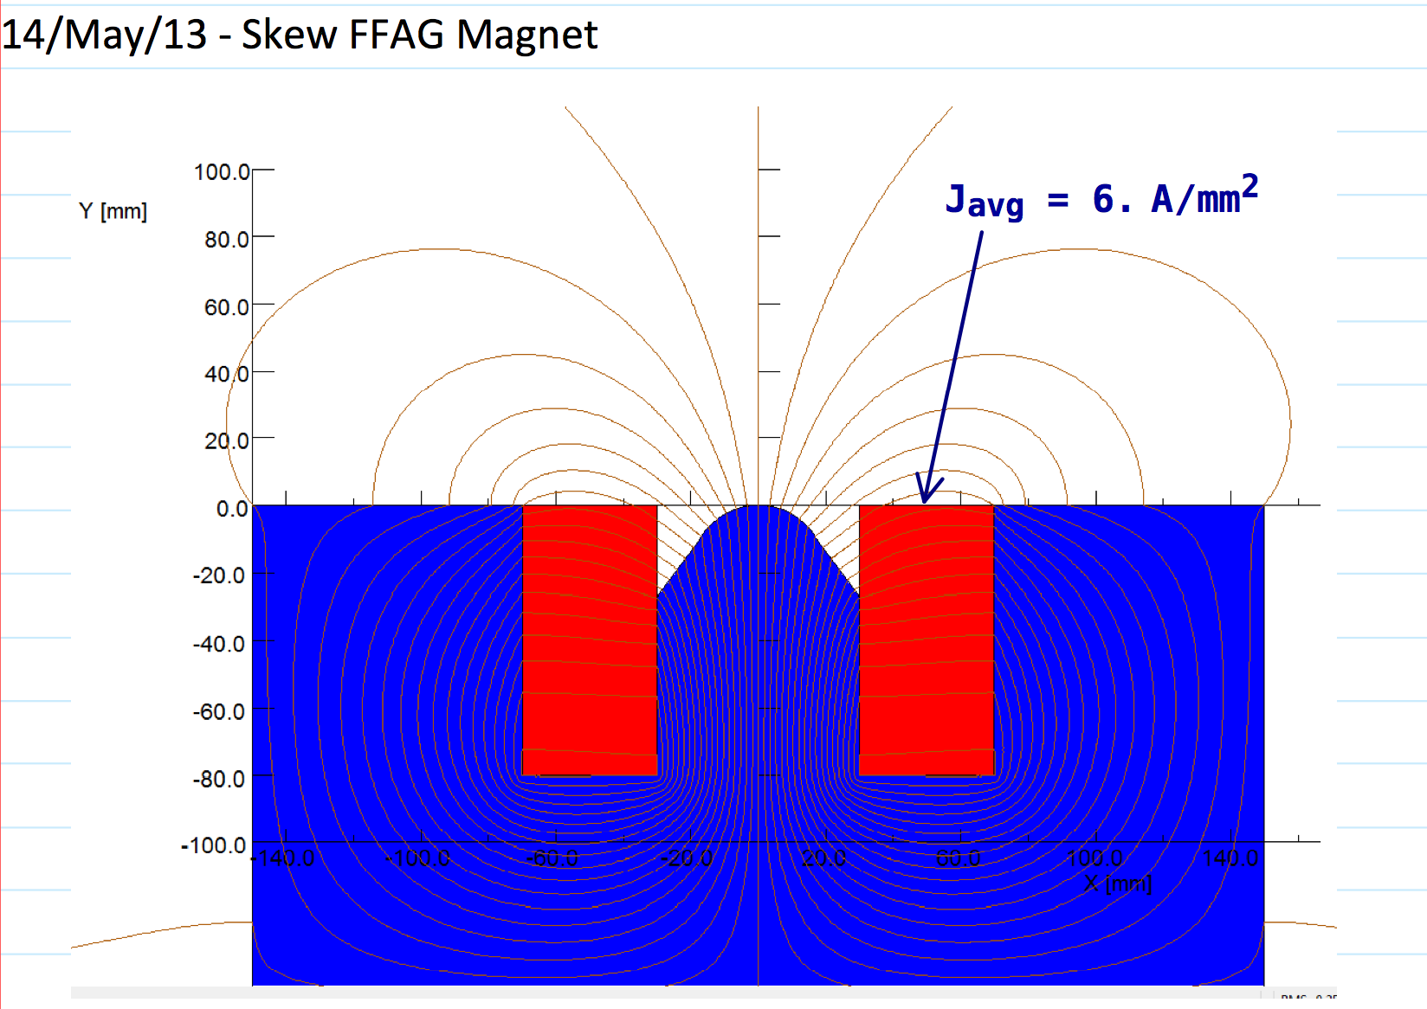
SOLUTIONS: VFFAG and Non-Scaling FFAG

Slide 8
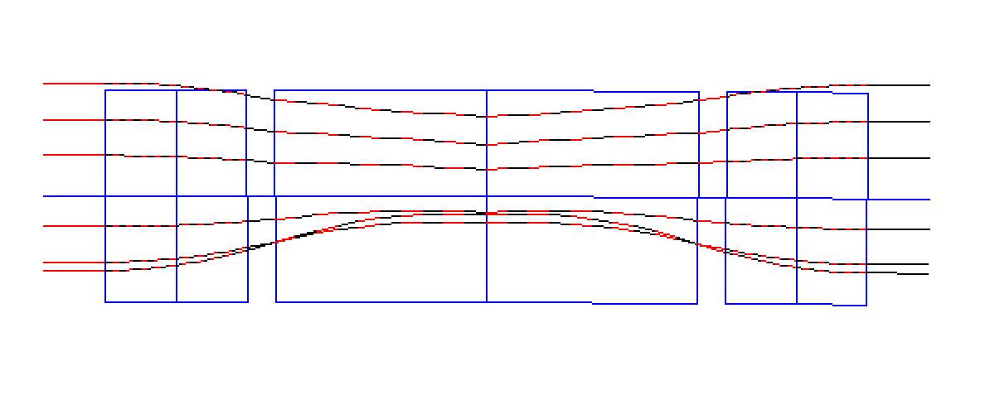
NS-FFAG with sextupoles 1.51 – 10 GeV
2.51 m
0.17
0.4 m
1.2 m
8 cm
0.4 m
0.17
9.2 mm
10.00 GeV
6.3 mm
8.585 GeV
3.2 mm
7.170 GeV
5.755 GeV
-2.9 mm
4.344 GeV
-7.5 mm
2.925 GeV
1.510 GeV

Slide 9
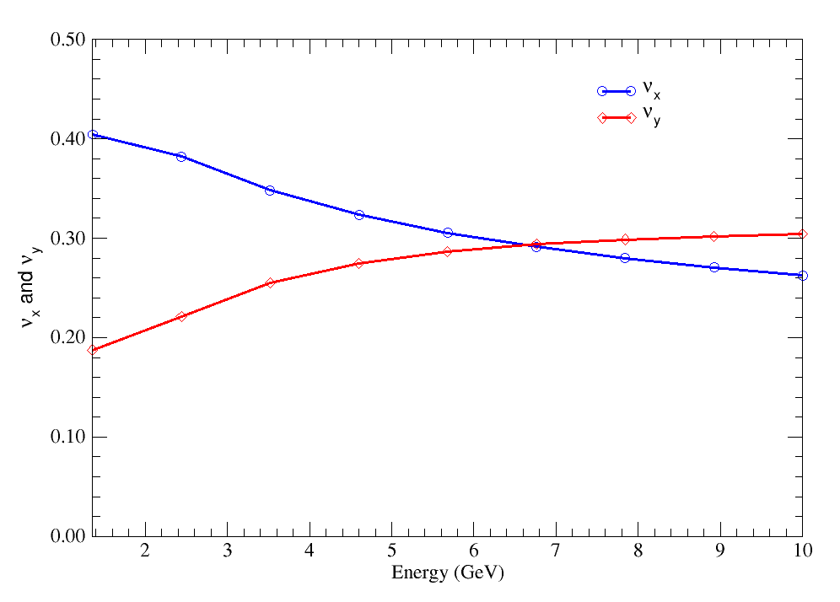
TUNES VS. ENERGY with sextupoles

Slide 10
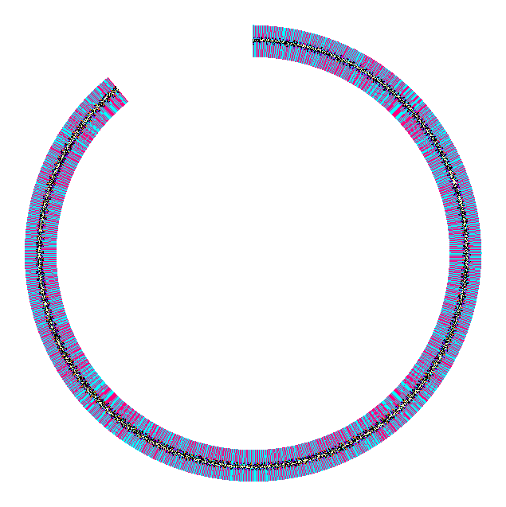
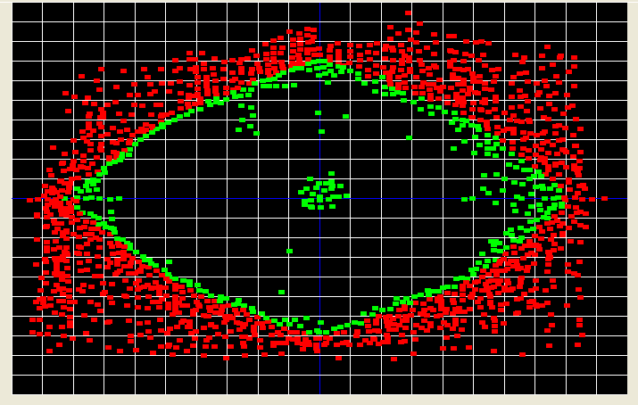
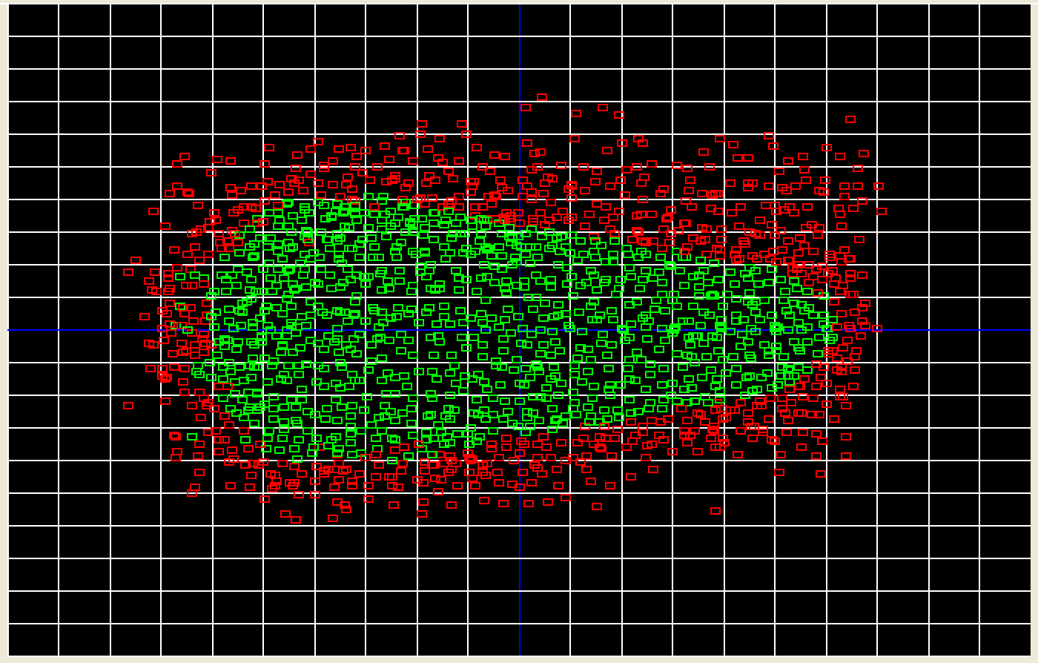
Dynamical Aperture 142*6 cells @ 10 GeV
LINEAR
WITH SEXTUPOLES
y(m)
y(mm)
1
1
0.5
2.5
0.0
1 m
0.0
-0.5
-2.5
-1
-0.5
0.0
0.5
x(m)
1.2
-5
-2.5
0.0
2.5
5
x(mm)

Slide 11
Two Non-Scaling FFAG’s
The central momentum p_{c} in the NS-FFAG creates the circular orbit for the reference particle.
Large Ring 2.8→10 GeV:
  p_{c} =p_{max}→ The circular orbit is at the top energy of 10 GeV while the minimum energy entering FFAG is 4.5 GeV.
  The energy gain: E_{top}/E_{in}= 10/2.8 =3.57 →
δp/p=(p_{min}- p_{max})/p_{max}=(p_{min}/p_{max}-1)= 0.357 - 1 = -0.72
2. Small Ring (two passes) 1.0 & 1.9 GeV
The energy gain: E_{top}/E_{in}= 1.9/1.0 =1.9

Slide 12
Two passes 1.0 and 1.9 GeV with small ring and nine in the RHIC tunnel 2.8 -10 GeV NS-FFAG
#N linac | E-linac | E-injector | Gain1-ffag | #N1-ffag | E top-ffag
3 | 0.9 | 0.1 |  | 2 | 1.9
9 | 0.9 | 2.8 | 3.5714 | 9 | 10.0
1.9
1.0
r_{o}
TOTAL NUMBER OF PASSES THROUGH THE LINAC = 12
3 passes to get to 1.9 GeV and
9 additional passes to get to 10 GeV
10 MeV
Electron gun
Two passes through
the linac 1.0 &1.9 GeV
90 MeV
~9 m
90 MeV
Passes through large
NS-FFAG in RHIC
#1 2.8 GeV pass# 3
#2 3.7 GeV pass# 4
#3 4.6 GeV pass# 5
#4 5.5 GeV pass# 6
#5 6.4 GeV pass# 7
#6 7.3 GeV pass# 8
#7 8.2 GeV pass# 9
#8 9.1 GeV pass#10
#9 10.0 GeV pass#11
Dump
Low energy
1.00 GeV
1.90 GeV
2.80 GeV

Slide 13
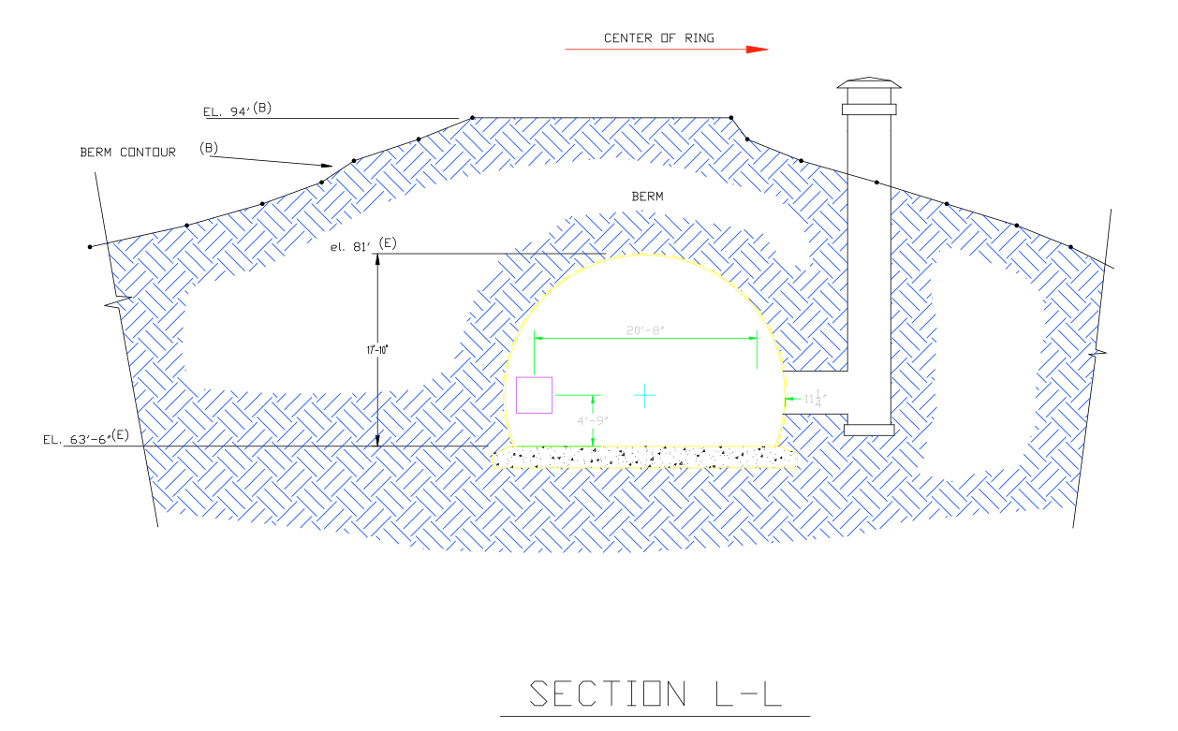
Two passes 1.0 and 1.9 GeV with the second ring in the RHIC tunnel 2.8 - 10 GeV NS-FFAG
0.9 GeV
~90 m
R_{o}~ 9 m or 30 m
Regular
transport
~9 m
90 MeV
Dump
Two passes:
#1 1.0 GeV
#2 1.9 GeV
20’ – 8”
17’ – 10”
6.8 m

Slide 14
Number of magnets for NS-FFAG:
One arc has 132 cells:
each cell has a combined function defocussing magnet QD and two QF quads
One arc has 132 cells 356.3 m = 132 BD, 264 QF
Total number of magnets in the six arcs :
BD comb. Def.: 132 x 6 = 792, QF’s=132 x 2 x 6 = 1584
TOTAL:
Combined Defocusing: 792
Combined Focusing: 1584
To be compared with previous
design of the six arcs:
Dipoles arc total = 2520
quad arc total = 3240
Without spreaders

Slide 15
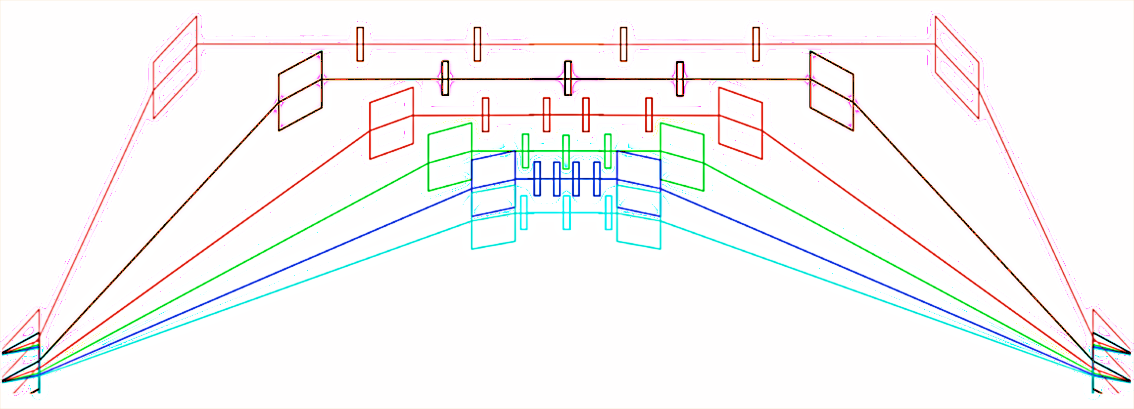
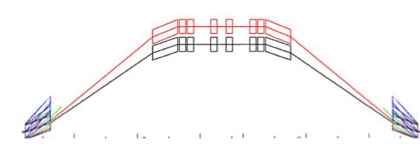
NS-FFAG matching to Linac
0.9 GeV
~90 m
Regular
transport
~9 m
90 MeV
Dump
Two passes:
#1 1.0 GeV
#2 1.9 GeV
r≈9 m or r≈30m

Slide 16
1 – 1.9 GeV NS-FFAG ring two options

Slide 17
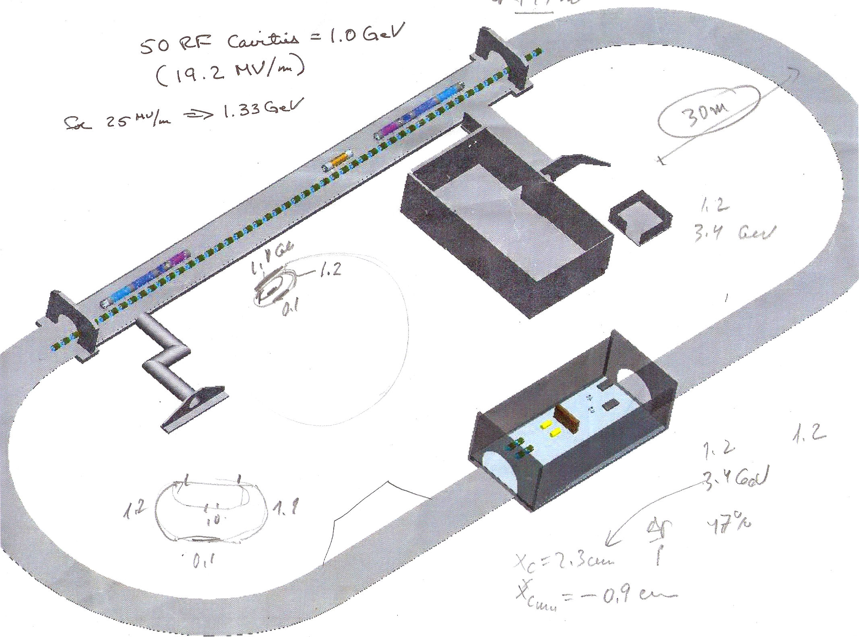
Possible place

Slide 18
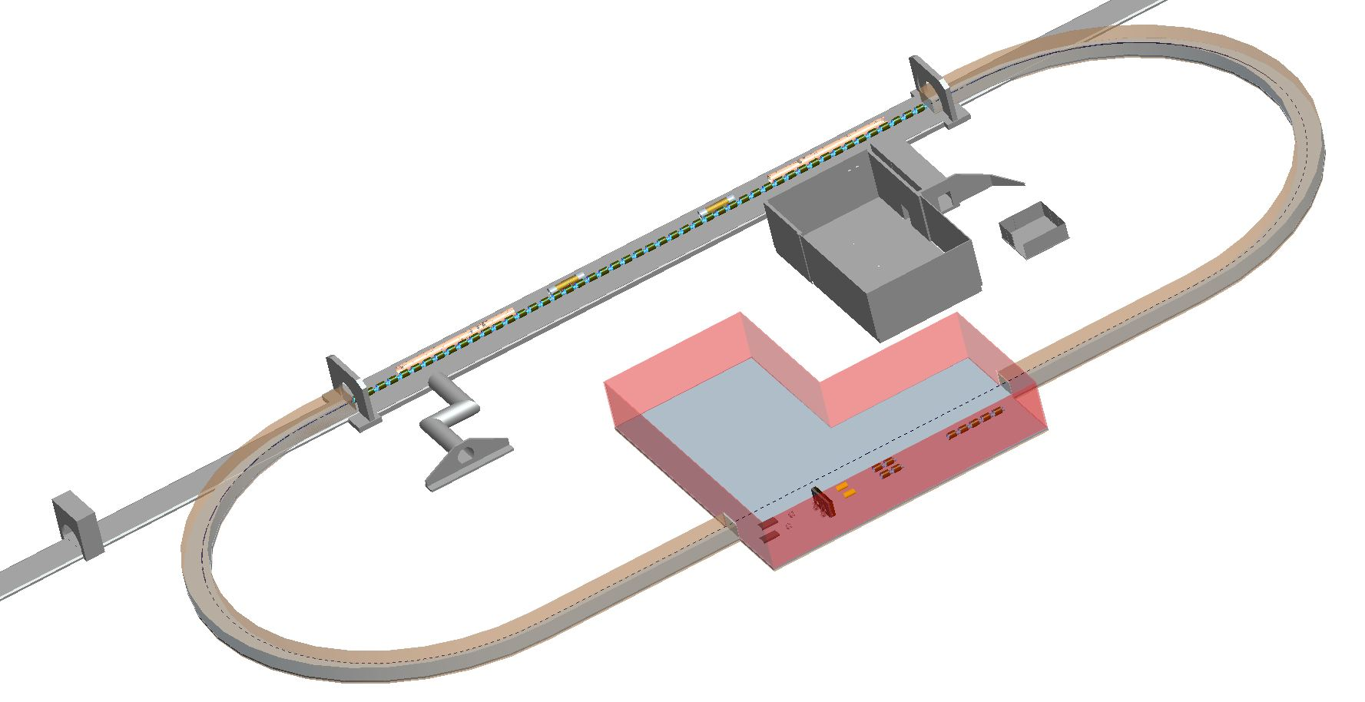
Possible place @ 10 o’clock

Slide 19
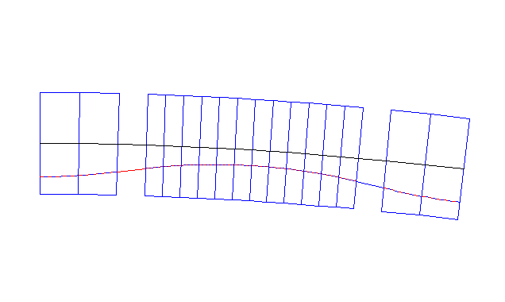
VERSION # 1 average radius = 9.93 m
1.20 m
-4.71 cm
1.0 GeV
1.9 GeV
0.22 m
0.60 m
0.22 m
θ_{F}=0.030208
θ_{D}=0.030207622
B_{YF}=0.87 T
B_{YD}=0.638 T
θ_{F}=0.030208
G_{F}=+34.964
G_{D}=-20.89 T/m
B_{YF}=0.87 T
G_{F}=+34.964
R_{D}=9.931 m
R_{F}=7.283 m

Slide 20
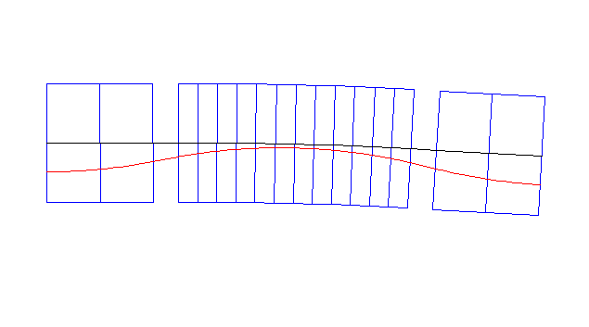
VERSION # 2 average radius = 30.0 m
1.545 m
1.0 GeV
-1.79 cm
1.9 GeV
0.33 m
0.725 m
0.33 m
θ_{F}=-0.00644
θ_{D}=0.06438
B_{YF}=-0.124 T
θ_{F}=-0.00644
B_{YD}=0.563 T
B_{YF}=-0.124 T
G_{F}=19.4 T/m
G_{D}=-14.25 T/m
G_{F}=19.40
R_{D}=11.26 m
R_{F}=-51.26 m

Slide 21
Large 2.8 – 10 GeV ring

Slide 22
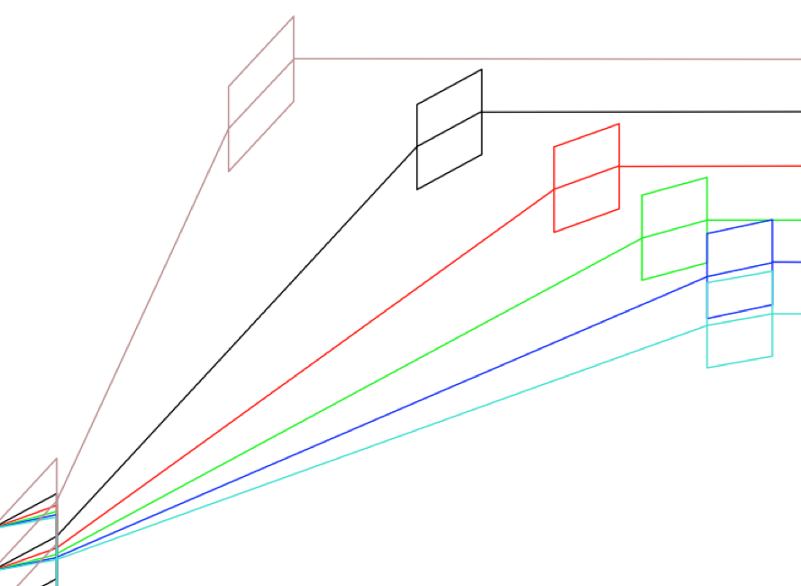
SPREADERS for the large ring
~80 m

Slide 23
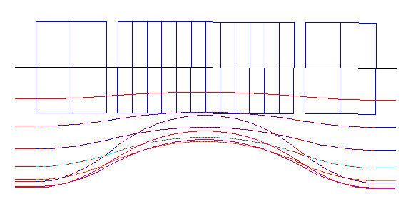
Basic Cell: 2.8 - 10 GeV -72%< Δp/p >100%
2.699245758 m
x(mm)
B_{f}=0.10 T,
G_{f}= 23.67 T/m
B_{D}=0.10 T, G_{d}= -17.9 T/m
B_{f}=0.10 T,
G_{f}= 23.67 T/m
0.0
10 GeV
-4.6
9.1 GeV
2.8 GeV
3.7 GeV
8.2 GeV
-8.6
4.6 GeV
7.3 GeV
-11.9
6.4 GeV
-16.7
-14.7
2.8 GeV
5.5 GeV
-17.5
-17.8
4.6 GeV
-18.1
3.7 GeV
0.145 m
0.5m
1.25 m
0.5 m
0.145m
θ_{F}=1.57 mrad
θ_{D}=3.9243 mrad
θ_{F}=1.57 mrad
ρ_{F}=318.529 m
ρ_{D}=318.529 m
ρ_{F}=318.529 m

Slide 24
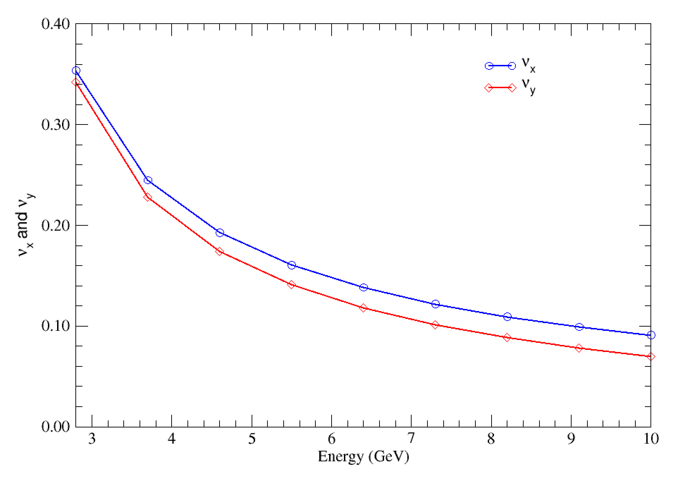
Tunes per cell

Slide 25
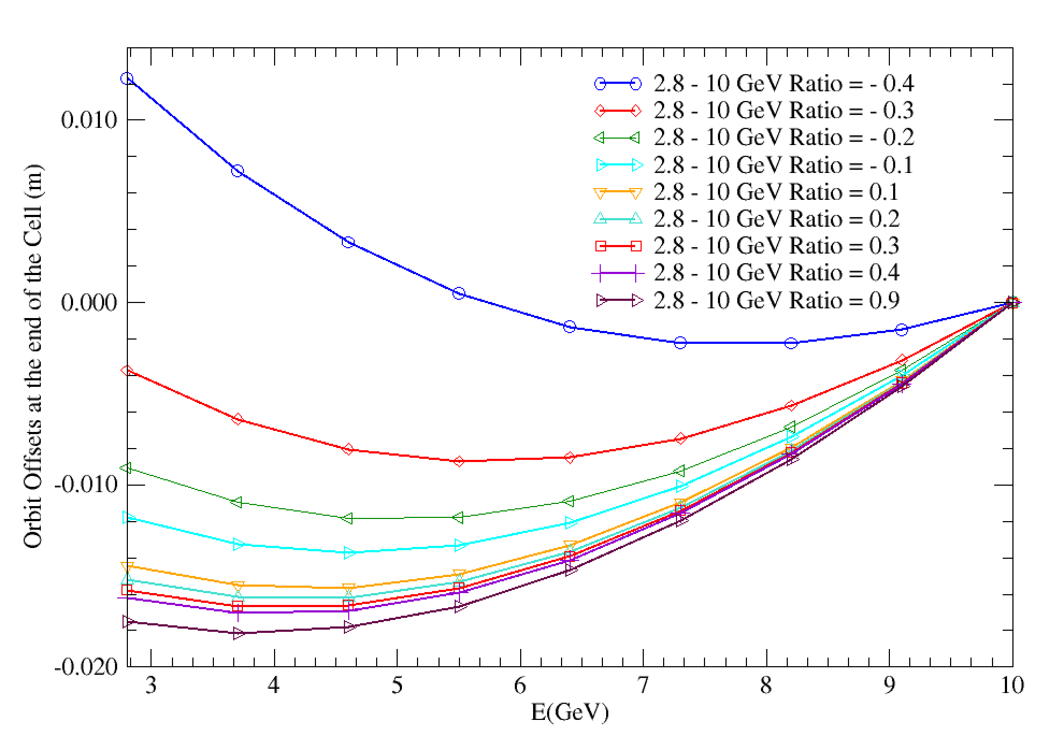
Orbit Offsets per cell

Slide 26
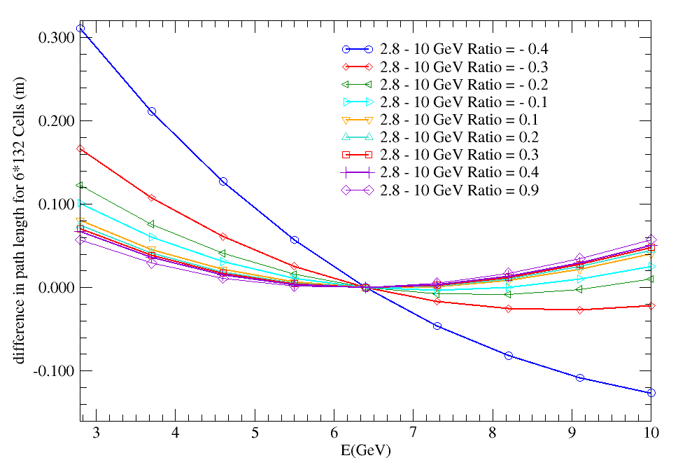
Path Length for 2.8 – 10 GeV lattice

Slide 27
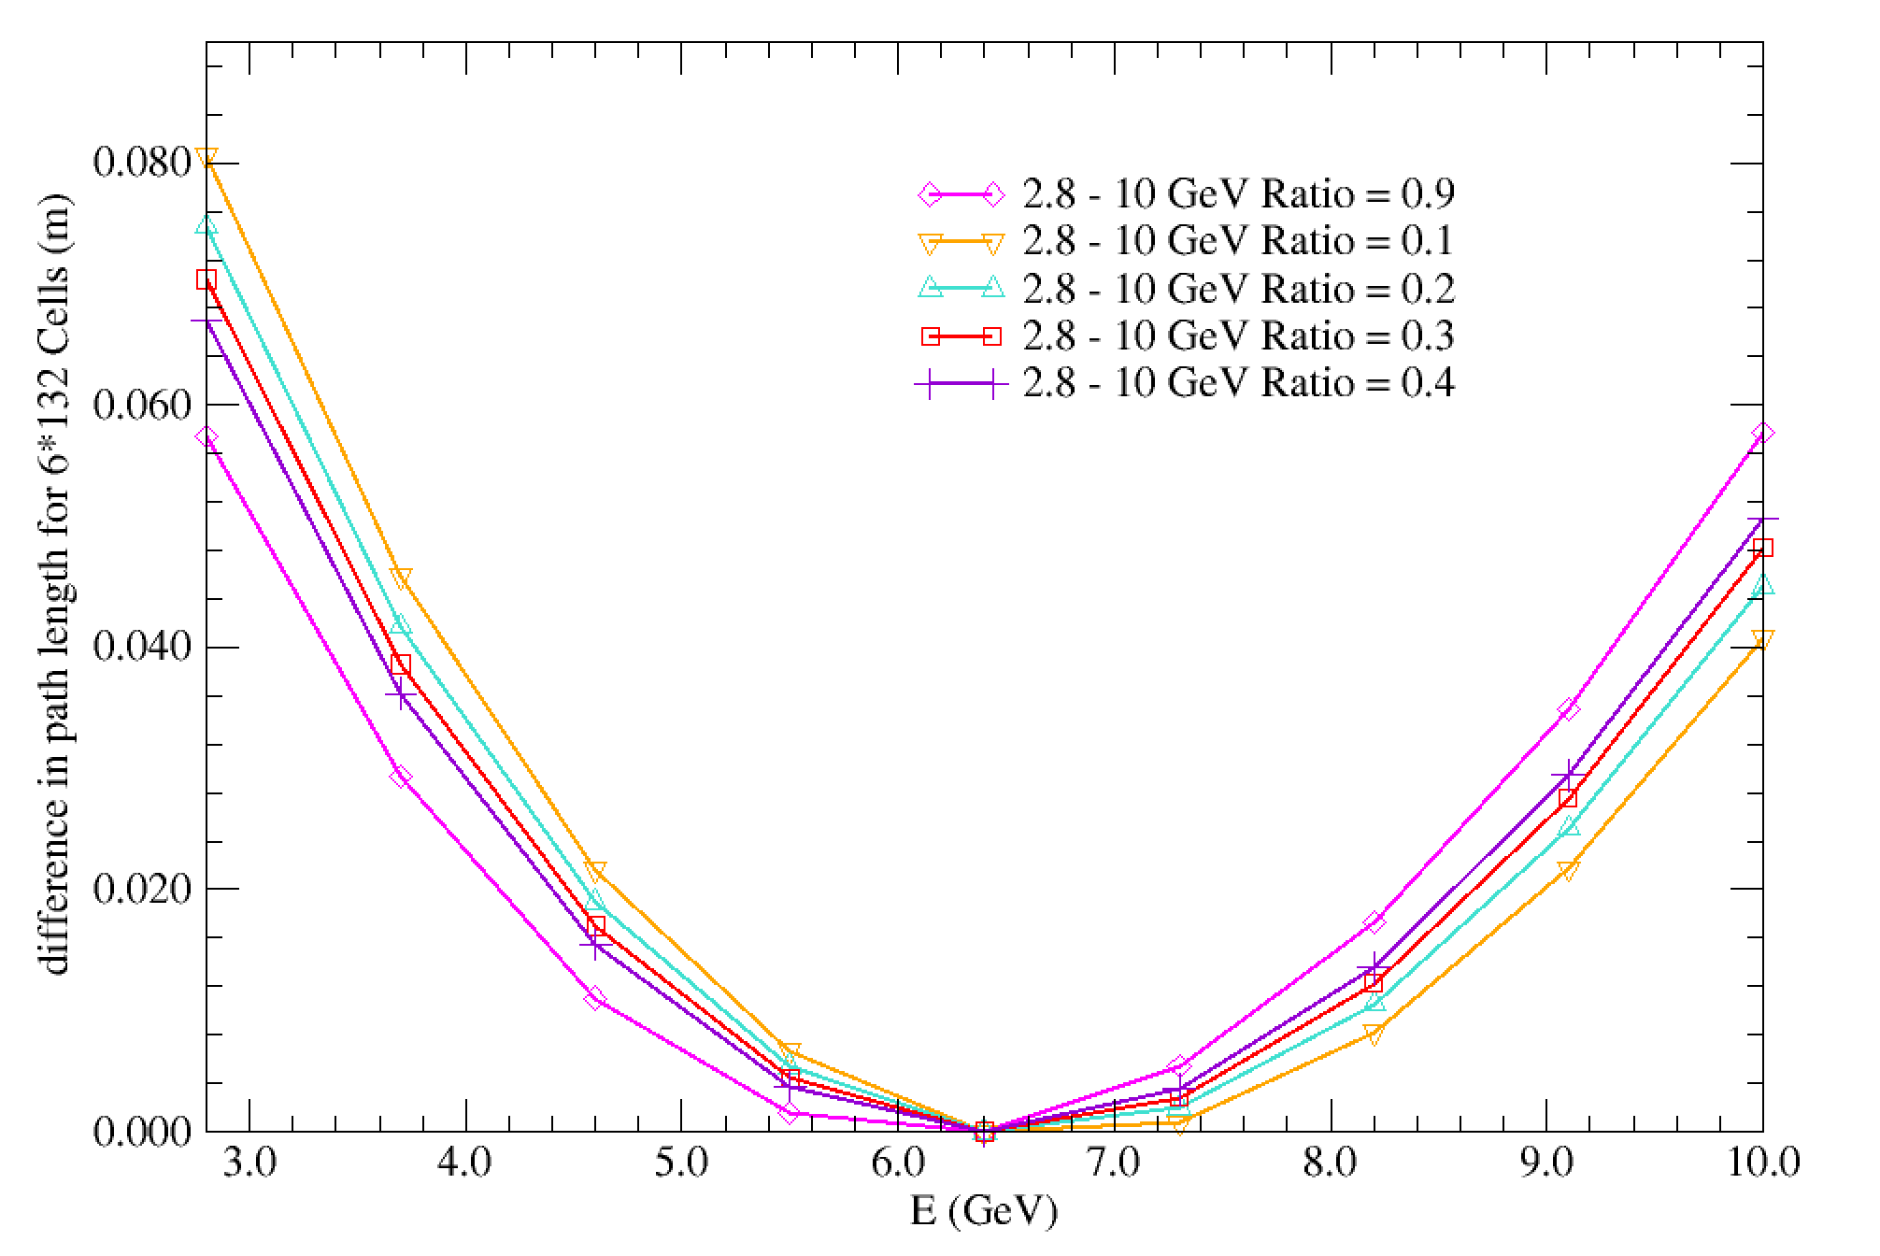
Path Length for 2.8 – 10 GeV lattice

Slide 28
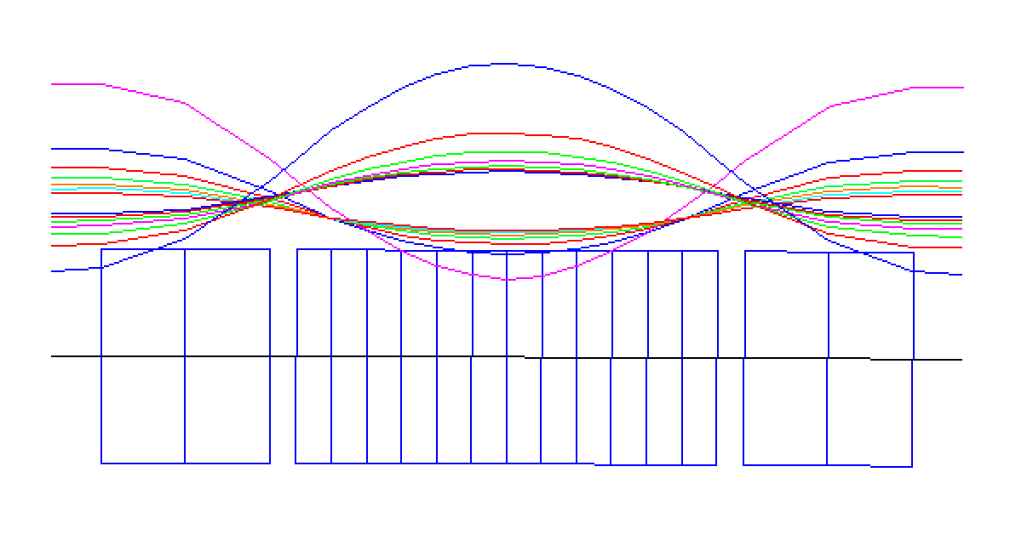
Betatron Functions for 2.8 – 10 GeV lattice
β_{x} and β_{y}
(m)
5
β_{y}
4.12
β_{x}
E=2.8 GeV
E=2.8 GeV
4
E=2.8 GeV
E=3.7 GeV
3
E=3.7 GeV
E=5.5
E=10 GeV
E=10 GeV
2
E=4.6
1

Slide 29
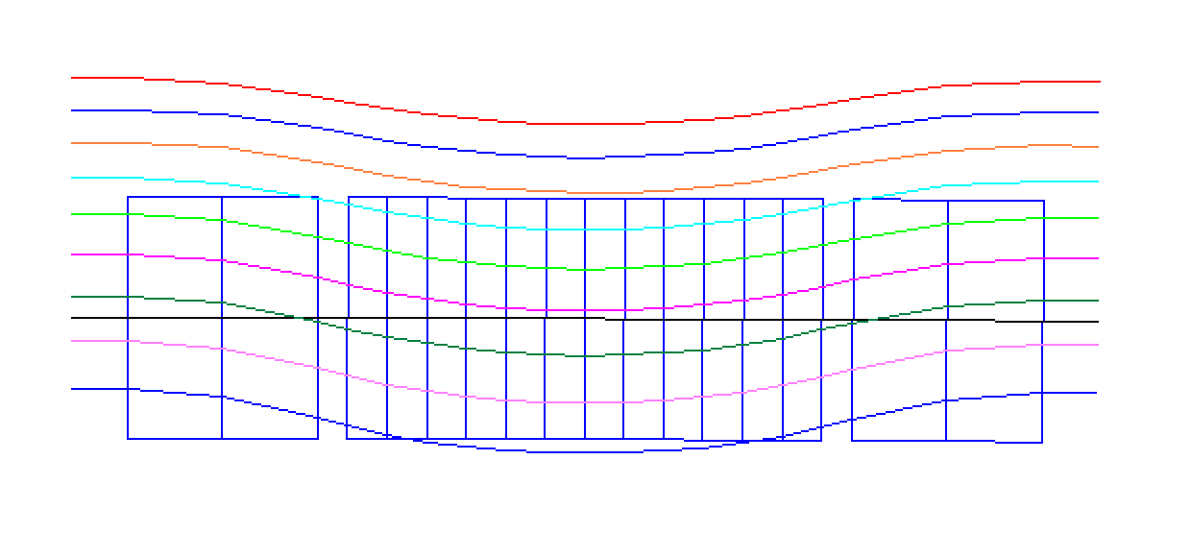
Dispersion for 2.8 – 10 GeV lattice
D(m)
0.07
0.06
E=10 GeV
0.05
E=9.1 GeV
E=8.2 GeV
0.04
E=7.3 GeV
0.03
E=6.4 GeV
0.02
E=5.5 GeV
0.01
E=4.6 GeV
-0.01
E=3.7 GeV
-0.02
E=2.8 GeV
-0.03

Slide 30
Delays for the large ring
Dipole magnet B=1.2 T L=1 m
Δs_{10 GeV}= 2.59 cm
Δs_{9.1 GeV}= 3.13 cm
Δs_{8.2 GeV}= 3.85 cm
Δs_{7.3 GeV}= 4.86 cm
Δs_{6.4 GeV}= 6.33 cm
Δs_{5.5 GeV}= 8.57 cm
Δs_{4.6 GeV}=12.26 cm
Δs_{3.7 GeV}=18.98 cm
Δs_{2.8 GeV}=33.24 cm
20 m
20 m
~40 m

Slide 31
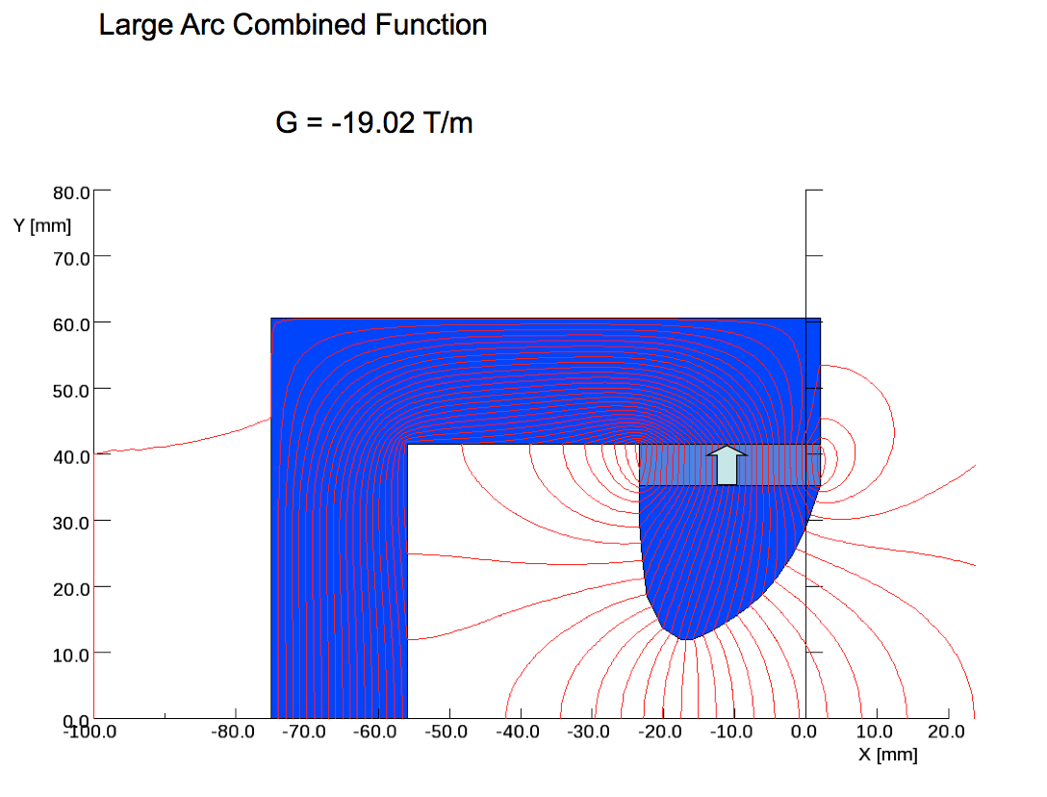
WUZHENG MENG:
Combined Function (D): Gradient = - 17.9 T/m [September 12, 2013]
B_{o} = 0.10472 T, B = B_{o} + G_{d} • x = 0.10472 + (-17.9)•(-17.1 mm)=0.41 T
Xmin ~ - 17 mm: (By = 0.3680 T)
Xmax ~ 0 mm: (By = 0.10472 T)

Slide 32
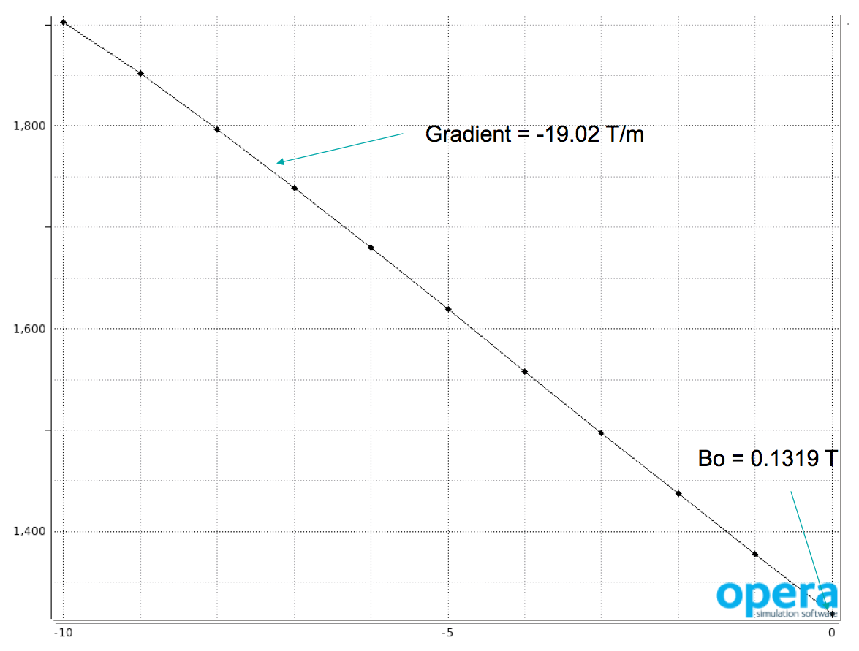
Large Arc Quads Requirements :
WUZHENG MENG:

Slide 33
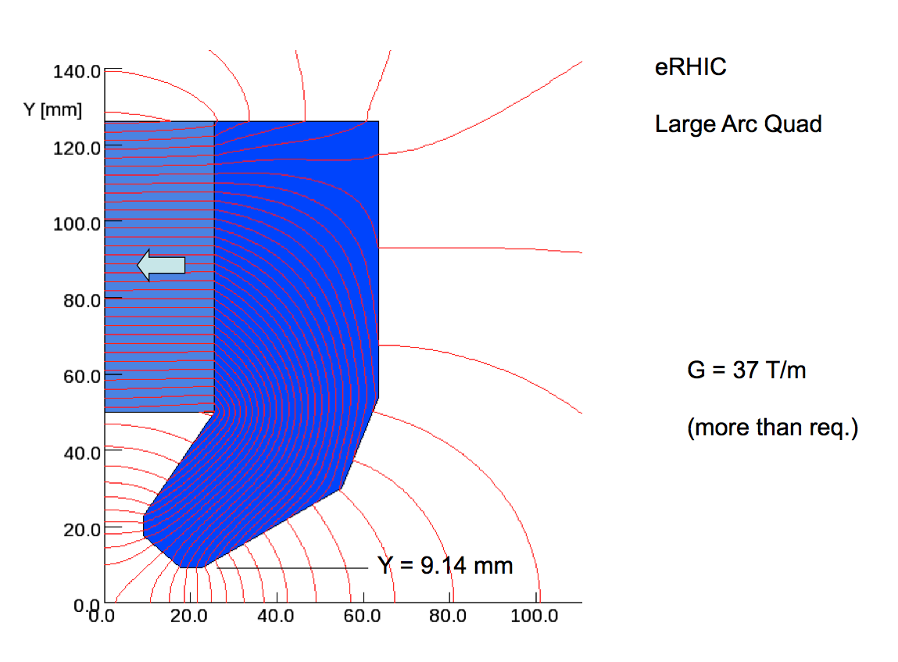
Large Arc Quads Requirements :
WUZHENG MENG:
Gradient = 23.671 T/m September 12, 2013
B_{o} = 0.10472 T Aperture R > 10 mm (design R = 13.5 mm)
B_{max} = B_{o} + G_{f} • x_{max} = 0.10472 + (23.671)•(-17.1 mm)= - 0.3 T

Slide 34
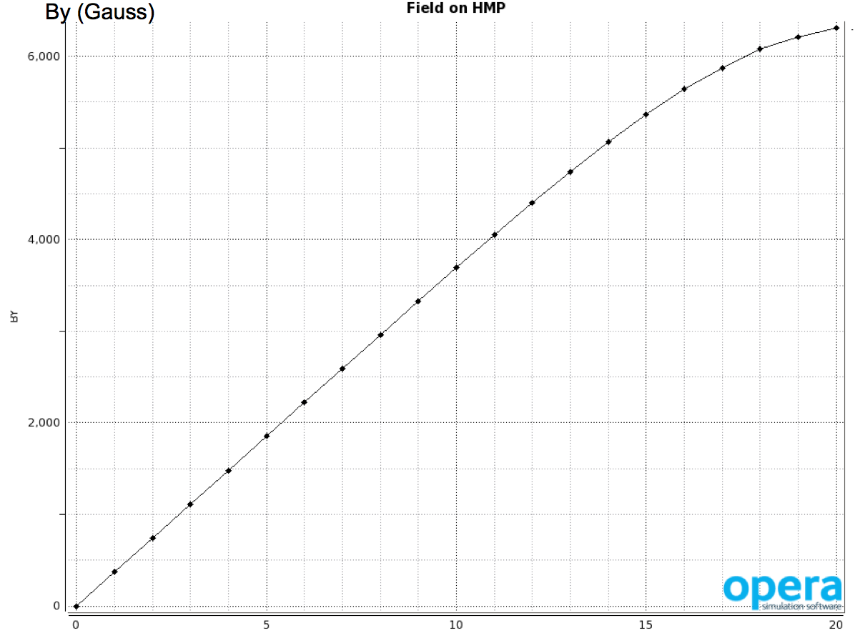
Large Arc Quads Requirements :
WUZHENG MENG:
Gradient = 23.671 T/m September 12, 2013
B_{o} = 0.10472 T Aperture R > 10 mm (design R = 13.5 mm)
B_{max} = B_{o} + G_{f} • x_{max} = 0.10472 + (23.671)•(-17.1 mm)= - 0.3 T

Slide 35
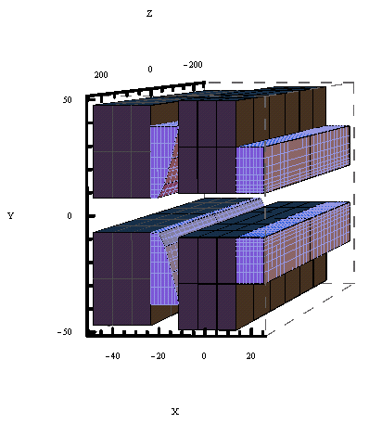
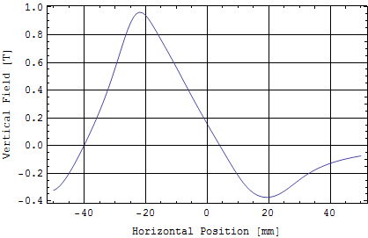
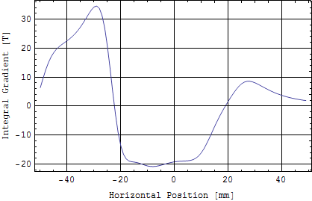
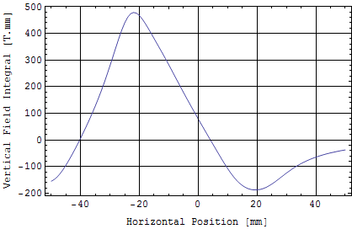
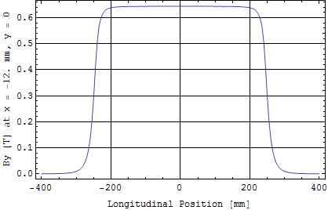
Test RADIA Simulations for e-RHIC FFAG Magnet: Hybrid PM “Wiggler Type” Geometry–Oleg Tchoubar
3D Model
B_{y} vs X in Center
d(∫B_{y}dz)/dx vs X in Center
∫B_{y}dz vs X in Center
B_{y} vs Z at x = -12 mm, y = 0
PM
Iron
Min. Gap: 15 mm
Iron Length: 0.49 m
PM Material: Sm₂Co₁₇, B_{r} = 1.05 T
PM Volume: 0.002 m³

Slide 36
Bypasses around Detectors and straight section

Slide 37
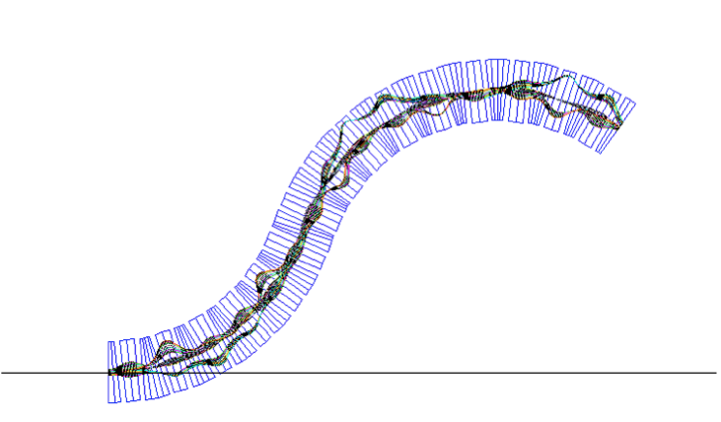
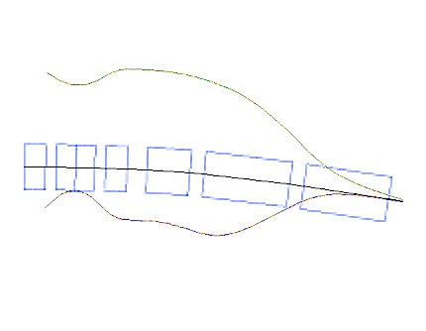
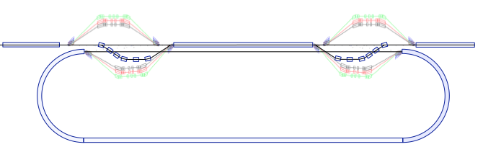
THREE possible solutions for matching
NS-FFAG to Linac:
With the special straight section
With few special arc cells at the end of NS-FFAG arc
The simplest is by the spreaders and combiners

Slide 38
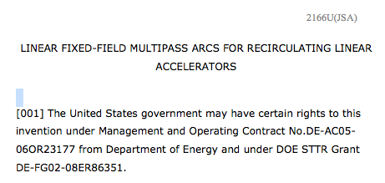
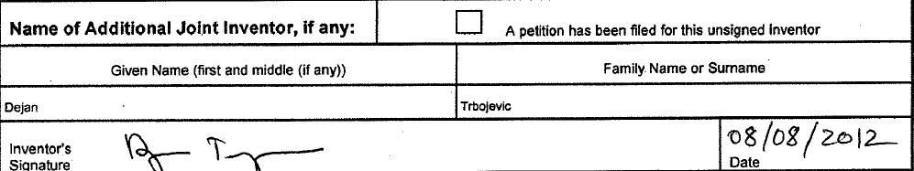
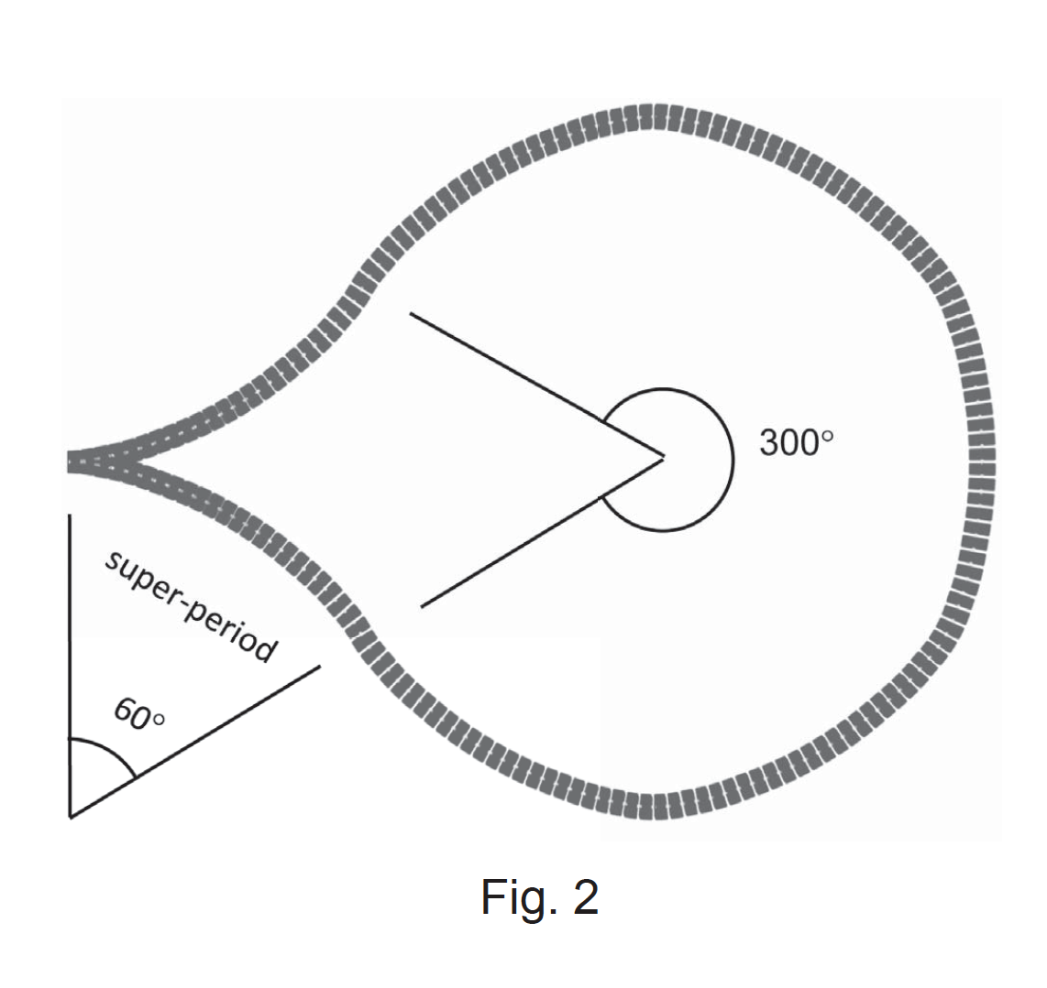
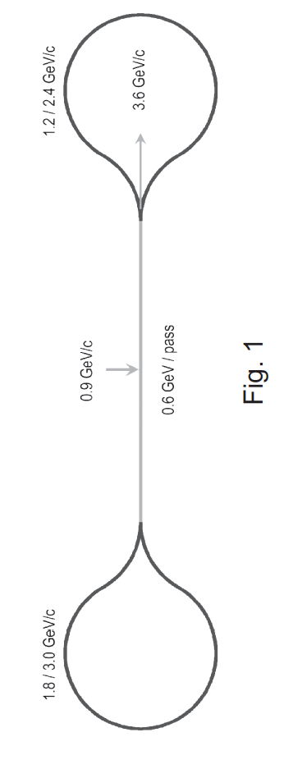
Jefferson Lab patent:
Gantry Patent:

Slide 39
Misalignment
E1=0.0001; !Simple MAs (DX,DY,DS)
E2=0.00005; !Lengthwise Rotation MAs (about Y and X axis) scaled to the Elements' lengths
E3=0.00005; !Twist Rotation about S axis (rad) 1 degree= .01745 rad
use, period=ARC;
select, flag=error, clear;
select, flag=error, class=rbend;
EOPTION,SEED=101;
EALIGN, DX:=tgauss(2.5)*E1, DY:=tgauss(2.5)*E1, DS:=tgauss(2.5)*E1,
DPHI:=tgauss(2.5)*E2, DTHETA:=tgauss(2.5)*E2, DPSI:=tgauss(2.5)*E3;
!EPRINT, full=true;
PTC_ALIGN;

Slide 40

E1=50 μm

Slide 41


Slide 42


Slide 43


Slide 44


Slide 45


Slide 46

E1=150μm

Slide 47


Slide 48


Slide 49


Slide 50


Slide 51


Slide 52

Lattice work for OC
Define lattice for a whole pass, instead of repeating one arc by 6 times
Separate a lattice file (lattice.ffag) from the main input file
Add monitors and correctors

Slide 53

Correction for low energy - X plane

Slide 54


Slide 55

Correction for low energy Y plane

Slide 56


Slide 57


Slide 58


Slide 59


Slide 60


Slide 61


Slide 62


