Slide 7
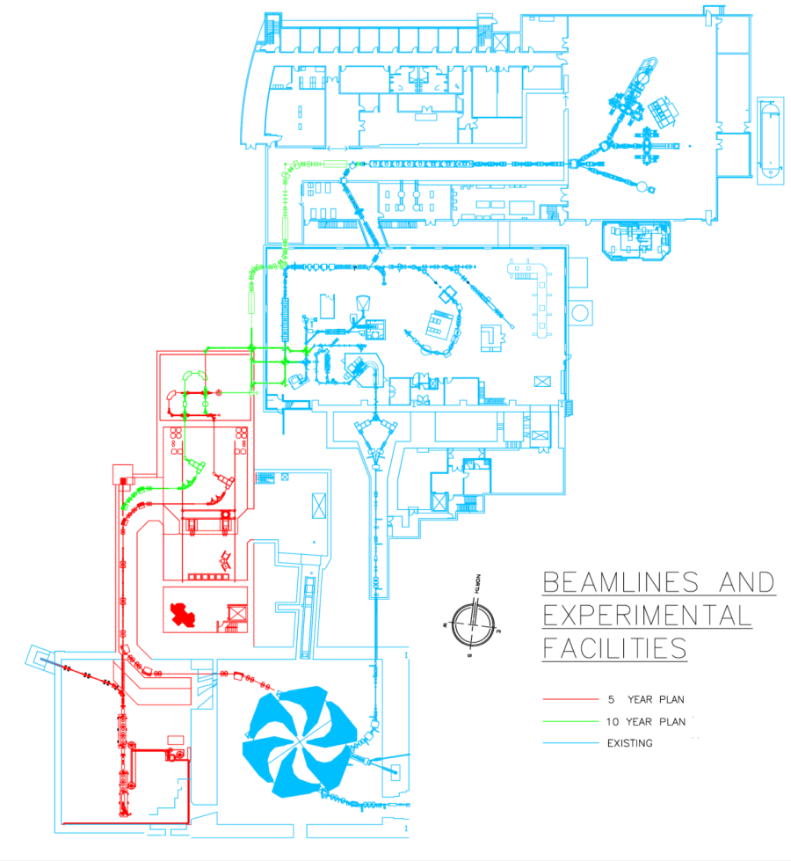
ARIEL eliminates bottle-neck & triples RIB science
ISAC II
10-Year Vision: expanded RIB program with:
  three simultaneous beams
  increased number of
  hours delivered per year
  new beam species
  increased beam
  development capabilities
Implementation:
Complementary
electron linac driver for photo-fission
New target stations and front end
New proton beamline
Staged installation
High
Energy
New
Accelerators
ISAC I
New
Front End
Low
Energy
Medium
Energy
New Mass
Separators
New
Targets
ARIEL I
ARIEL II
Existing
e-linac
Cyclotron
Notes:
The TRIUMF 10 year plans address the problem that there are three RIB experimental areas that could run concurrently,
but there is only one drive beam - The existing H- cyclotron. The 10 year plan is for 3 simultaneous beams.
Starts with the electron linac, and new targets and front end in the ARIEL building.
Second component is the installation of another proton beamline, BL4North.
7

Slide 8
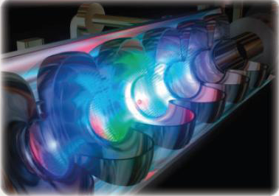
ARIEL Mission Statement
The primary mission of ARIEL is to deliver unprecedented intensities of rare, short-lived exotic isotopes, and in particular those with extreme neutron excess, to simultaneous and multiple experiments, at the existing and world-leading ISAC accelerator complex.
Courtesy Greg Hackman (TRIUMF staff scientist)
A secondary mission of ARIEL is to anticipate future uses of e-linac technologies such as free electron lasers, and including commercial uses such as the production of medical isotopes by photo-fission.
Notes:
The ARIEL mission statement is nothing short of stunning.
I shall read it.
This is the territory of glory for the Canadian nuclear physics community.

Slide 9
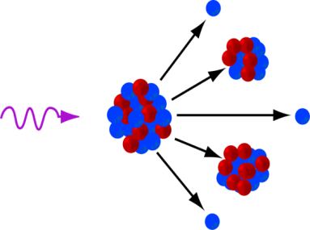
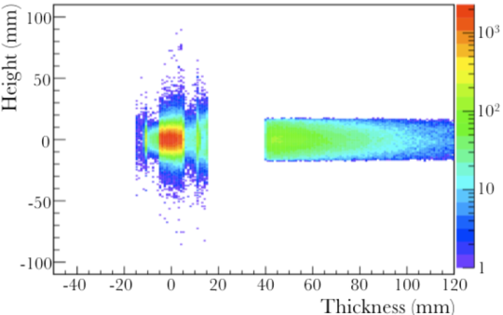

Photo-fission production of Rare Isotope Beams
neutron
Photofission of ²³⁸U was proposed by W. T. Diamond (Chalk River) in 1999 as an alternative production method for RIB.
Fission
fragments
High energy
Photon
neutron
Fission
fragments
neutron
Electron-
Photon
Converter
²³⁸U
Target
Mass Separator
RIB
User
E-linac
Ion Source
E-beam
RIB & neutrons, γs
Notes:
Neutron-rich heavy nuclide production will be from photo-fission of a uranium target.
The electron beam falls on a convertor, to produce bremmstrahlung gamma-rays.
These in turn fall on a production target, followed by isotope separation on line.
Figure shows power density levels in the convertor and target.

Slide 10
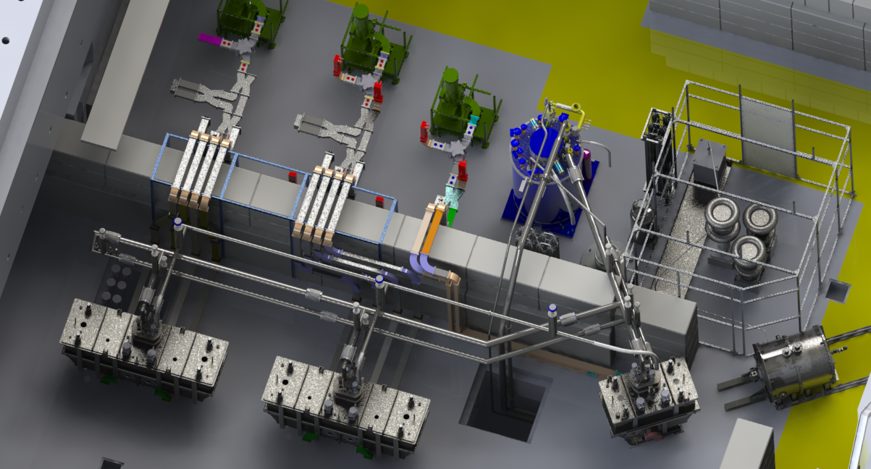
E-Linac in e-hall
Accelerator
Two cryomodules
Two 9-cell cavities/module
10 mA, 40 MeV gain
≤ 400 kW beam power
Klystron
Cold box
HV Cage
Injector:
Thermionic gun: 300 keV in SF6; 650 MHz
EACA alone installed 2014 July 10
3 mA, 5-10 MeV gain
≤ 30 kW beam power
Notes:
On the tour you will see coldbox, dewar and klystron in e-hall.
Gun HV cage and SF6 vessel at VECC
EINJ at ISAC

